Slide 1
Staying Calm in Times of Crisis
Shelle McDermott
Author, Speaker, Prepper
Contact: cimprint@live.com
Notes:
Hello Everyone! Shelly McDermott here again. I’m going to talk on Staying Calm in Times of a Crisis – Many of you already know me as an author and speaker. I usually speak on spiritual preparedness and temporal preparedness, but today, it is strictly temporal, although I am a firm believer that one is no good without the other!
Again, if you want to contact me with questions or ideas, there is the email address.

Slide 2
Introduction Session 2
Today you will hear 30 more of my favorite preparedness ideas to inspire you to be prepared before a crisis happens.
Again how to save time and money.
Again how to get organized ahead of any crisis and get everyone around you involved.
The next two 1 hour sessions will be:
Food/Water for Long Term Crisis (1 hour)
Shelter/Safety for Long Term Crisis (1 hour).
Notes:
Read slide.
Remember, You can call me the Prepper Cheater. If it takes to long or costs too much money, I probably won’t do it. You have heard the expression, “It’s either your time or your money.” It takes both! Don’t be embarrassed that you have been at this for a few years. I’m here to pass on some great ideas to get you organized ahead of any crisis, immediate or long term.
Just remember, you have about 80% of what you need to prep in your home now. You just need to organize it and keep track of it. Because when you are prepared, ye shall not fear!

Slide 3
Remember Preparedness is the key!
The chaos doesn’t end, you just become the calm….
Notes:
Remember to have monthly family meetings to get everyone involved and used to “emergency talk”. Don’t scare anyone, just use the current headlines to ask, “What could we do to prepare if that happened to us?”
You got this!

Slide 4
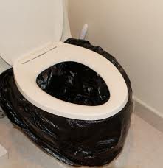
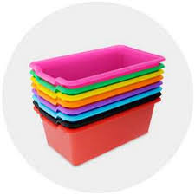
#1 Sanitation When the water goes off.
Line home toilet. Line with 2 larger trash bags. Then place a large plastic tray in the toilet. Line the tray with a smaller Walmart bag. Then place a “puppy pee pad” in the Walmart bag to absorb the liquid.
When finished bring all four corners of the Walmart pad together and drop into a lined bucket ready to take for disposal later.
Notes:
Read slide.
Be sure to double line the bag to prevent any leaks. Once the water has been shut off, you can remove remaining water and use a tennis ball to plug the toilet.
If you don’t have the puppy pee pads to line each use, then use cat litter or dirt before and after each use.
Don’t forget to use latex gloves when transferring bags around or cleaning.
You can buy the trays at the dollar store.
The puppy pads are cheap on Amazon. The Glad Brand was about .17 each. I cut them in half.

Slide 5
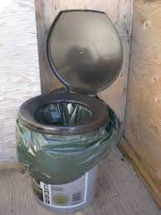
Sanitation Away From Home
If outdoors, make toilet buckets. Buy toilet seat for buckets or use a foam noodle.
If no “puppy pee pads” scoop, line larger bag with Walmart bag and scoop dirt/litter before and after use.
When done lift bag and drop into larger bag to go to the dumpsters or to be buried later.
Notes:
Read slide.
Foam noodles can be found at the dollar store.
You can attach the toilet paper roll to the side handle of the 5 gallon bucket.

Slide 6
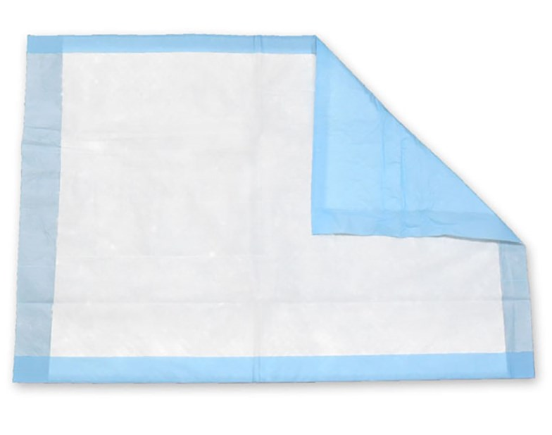
More Comfort Sanitation
A nursing home type toilet provides for stability for older folks. Line the tray with Walmart bag first, then line the Walmart bag with a puppy pee pad, when finished pull the Walmart bag up and out or just the liner by the corners. Drop into bigger bag.
The puppy pee pad provides no splash back and no spillage!
The toilet was on Amazon for $35.
Notes:
If just urine, the pad can be used multiple times.
Assign each person their own bucket or toilet.
Always wash hands after. Have latex gloves on hand for clean up.
Remember Cholera can break out with poor sanitation management. Always dispose of waste AWAY from camp.

Slide 7
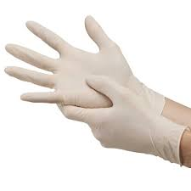
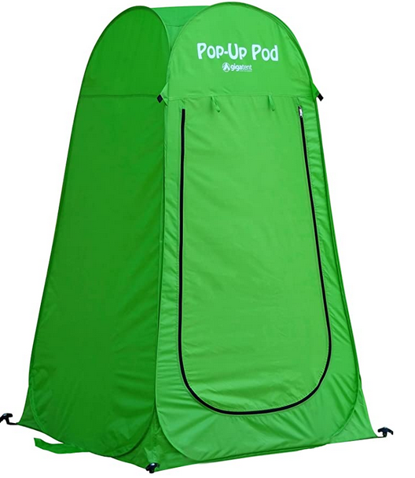
Advice for Sanitation
Put spray bottle of vinegar and water next to the commode to clean between use. Keep latex gloves nearby for clean up.
Use the spray bottle to clean hands too.
Each person should have their own bucket or commode to stop the spread of disease.
A pop up tent for a shower, toilet and dressing room is perfect for a crisis. $33 Amazon.
Notes:
Read slide.

Slide 8
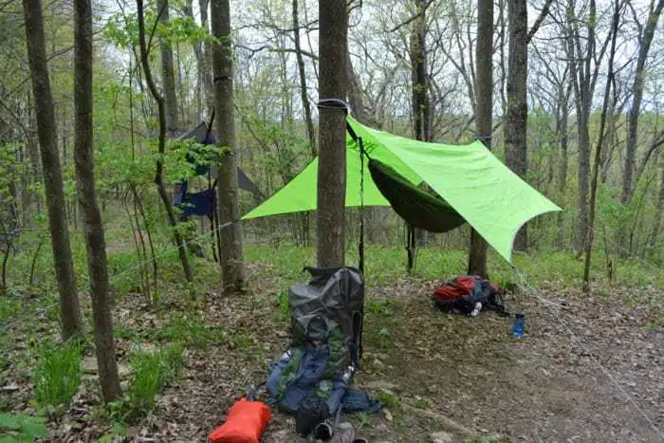
#2 Alternative Bedding
Hammocks ($20 Amazon)
Notes:
If you are displaced, it is a good idea to have some compact alternative bedding in your evacuation bin.
Hammock for $20 (Amazon) Stuff into little bag on the edge.
I slept in one for the first time last summer and it was some of the best sleep of my life. There is a flap you can throw over you to keep the bugs off.
If you are in the high country, you will want to climb up more to attach your hammock to keep animals from coming near. If you keep a fire burning through the night or even solar yard lights around you, that will discourage animals from coming near you. However, bats love lights because that means there are bugs to eat!
If you are in bear country, it is critical to store your food away from where you sleep. Hang your food high in a tree on a limb away from where you are sleeping. Do not take snacks with you to bed or have crumbs on your clothing. Try to camp in large numbers and keep noisy, maybe play a radio. Spray pine sol around the camp. Bears are deterred by that smell. Consider sleeping with a stun gun.
If it is raining, tent a tarp over your hammock.
Hammocks, especially netted ones are excellent for hanging inside tents near the ceiling to create more storage space for supplies. You can never have too many hammocks in a camping situation.

Slide 9
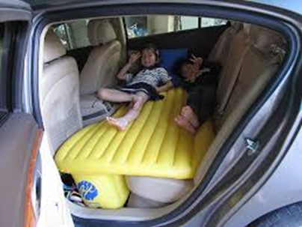
Convenient, Easy, Inexpensive
Self Inflatable Blow Up Mattress (Set up on Buckets) $25
Self inflatable Car seat mattress $39
Notes:
Read slide.
The car seat bed allows for the vehicle to become it’s own safety shelter. Notice the foundation also inflates to make the bedding area larger and more stable.
An inflatable mattress does turn cold if there is cold are under it, like when you place it on a cot. Try to find a solid under base like a grid of buckets.
Wool blankets, often found at army/navy stores, are excellent insulation against cold. Harbor Freight stores carry them for cheap too (around $10 ea.). Line your sleeping bags, layer on your air mattress, wear wool socks, wear a wool beanie, wear a wool scarf wrapped around your neck and chest.

Slide 10
More Long Term Bedding
Notes:
Cots, bunk bed cots, air mattress on an oversized cot, or a regular mattress on a platform of 5 gallon buckets!
Stackable cots can help with small children and using tent space.
Warming up water either at a campfire or in a solar oven or bag and transferred into a plastic water bottle then placed into sleeping bags can warm up any bed situation.
Warm up bean bags or small rocks on a skillet or in a solar oven to place into sleeping bags to create a cozy warm bed. Do not get so hot you burn your sleeping bag.

Slide 11
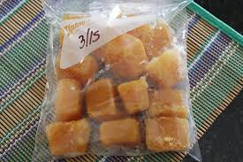
#3 Store up Eggs on the Cheap!
Crack and freeze in ice cube trays. Pop out and put in Ziplock bag. Fresh instead of powdered!
Notes:
Read slide.

Slide 12
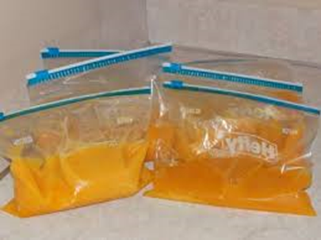
Eggs and More Eggs!
Or skip the ice trays. Place whole or scrambled into Ziploc bags.
Good for 1-3 years in the freezer, or rotate into your cooking needs.
Or pick an important date to cook them like for New Year’s Eve breakfast to remind you to use them then replace them.
Buy those laying hens! When stores become obsolete, you will want your own source of eggs.

Slide 13
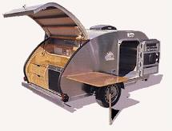
#4 Long Term Displacement
Long term displacement. Cabin? Family? Campground? RV? Tent? Pick a spot and plan for it!
Notes:
Don’ read.
If you are displaced long term or getting ahead of a coming calamity (hurricane, tornado, earthquake, fires) where will you go? Skip the FEMA camps by being prepared!
Do you have a family cabin? Favorite campground? RV? Distant Family members? You can preplan and pre-pack with old clothing and dollar store items and store away from your home for peace of mind.

Slide 14
Pre-Packing for Long Term Displacement
Prepack for each person
Have bins, bags, boxes pre-purchased to load up supplies or items you are still using some of your supplies.
Pack higher sizes for children to grow into.
Used clothing is just fine and will do the job.
Notes:
Read slide.
Pre-plan and pre-pack!! At least have empty buckets and bins to throw things in that you have to take last minute. Have lists of each room where supplies are.
I have gone to clear bins for quick and easy identification of what is in the totes and an inventory sheet taped on the top with the person’s name who the contents are for.

Slide 15
Each Person Should Have the Following
Sleeping bag and pillow. 3 cases.
Wool blanket and camp blanket.
4 or more towels, several aprons.
Flip flops for showers, 2 shoes for working, hiking shoes, mud shoes and deep winter shoes. A dozen socks.
Hygiene supplies and hair supplies. Don’t skimp.
Jackets, hoodies, parka, beanies, gloves, scarves.
Swimsuit for bathing. Belt or suspenders for losing weight.
Scriptures, journal, pens, art supplies.
Hats, visors, sunglasses, goggles, Aloe vera gel and sunblock!
Winter clothing and summer clothing.
Notes:
Don’t read.
Each person should have their own buckets and bins stored in case you are separated and they are in another area.
Each person should have a minimum of the following items. Remember, you can use old clothing, or future sizes, or thrift store purchases. You can use items already in your home or pick up at the dollar store.
Sleeping bag and pillow with at least 3 cases. The sleeping bags can be bought off season on Amazon and should be a below zero degree rating. (Coleman on clearance for $25 each). The cases are in case you cannot do laundry often. Turn them inside out.
A wool blanket is a must. You can create more heat with them. You need a separate lap blanket for around the campfire. You don’t want your sleeping bags to be used around a campfire. These can be homemade quilts from old clothing.
Towels will be a premium. You will always have some drying while you are using clean ones. In the winter without a dryer, it will take longer for the towels to dry. Unfortunately, camping is messy. You will want to store old towels for rags to clean up messes. Color code them if possible to identify quickly who the towel belongs to or put their names on them with a sharpie. Use old towels or buy bulk packages like Sams Club and divide them up.
Put some smaller hand towels in their supplies as well. Sometimes you don’t need a big towel for a smaller mess or dry your face or hands. Again, stop the spread of disease. Provide everyone their own towels!!
Store up several aprons for each person. They can be used for tending animals, gardening, cooking, cleaning, and playing. Aprons are easier to clean and can soak while waiting for laundry to be done. They keep your clothes clean but they also extend the life of your clothes. Our ancestors knew what was going on!
Flip flops will be essential for standing in dirt for a shower. Other shoes to store up for are tennis shoes for working – at least two pairs in case one gets wet or muddy! Hiking shoes for activities away from camp. Mud boots/rubber boots for rain days and deep winter boots for snow days. I bought all our snow boots off season and paid ¼ what they would have been new.
Socks. Socks will keep your feet from blisters, more comfortable during work, keep you feet warm at night, keep your feet from drying out and cracking your skin. Always keep a pair washing or drying. You will run through them.
Hygiene supplies are as simple as toothbrush, toothpaste, deodorant, shampoo and conditioner, lotion, lip balm and feminine products.
Jackets and hoodies. Save them up! You will use them to layer and stay warm. You will also be waiting for some to wash and dry. A deep winter parka is a must when you are living without additional heat sources. I bought a three layer one on Amazon for $45 on clearance. We tested it out and yes, it overheated at times.
Multiple beanies and gloves of all kinds are a must when living in the open. Wool should definitely be one of your choices. Beanies are also good for holding back dirty hair. Water will be a premium in some cases.
A swimsuit will provide privacy for showers, baths, and swimming.
A belt or suspenders will work for clothing as you begin to lose weight living in a camp situation.
You can trade clothing sizes around camp with others to replenish growing children or adults who are downsizing in weight. You can buy tshirts for $1 now at the dollar store, even less at thrift stores, store them up every chance you get. The material can be used for rags if you don’t end up using them.
Often it is our spiritual renewal that helps us to get through tough times. Make sure everyone has a scripture bag with a journal, pens, writing paper, color pencils and so on to help with daily devotional time.
The sun can be brutal when living outdoors. Store up hats, caps, sunglasses, goggles, aloe vera gel and sunblock!
Winter and summer clothing should include about 7 outfits for each season. Don’t forget underwear!

Slide 16
Keeping Your Non-Food Supplies Organized
Make a list of things to pack last minute that you are still using at home.
Possibly store at alternative location like a cabin or in an RV.
Optional: Use “banker boxes” to create a uniform storage system and alphabetize your supplies for bugging out. Makes for quick loading. $2/box Sam’s or Costco.
Notes:
Read slide.
In addition to the buckets and bins for each individual, I would suggest collecting other items that will be useful in a grid down situation, a long term camping situation, a resource center for sharing items you are also collecting.
Other possible items to store: Medical Supplies, Gardening Tools, Assorted Headwear, Assorted Gloves, Dishes, Solar Jars and Pans, Washcloths, Cleaning Supplies, Laundry Supplies, Electronic Supplies, a library box, music box, an art and game box, sewing box, candle making box, baby items box, family documents box, small tools box, MacGyver box (will explain in another slide) etc.,

Slide 17
#5 Quarantine in Home
Quarantine in home. Masks? Gloves? Sheeting? Disposable dishes? Sanitizers? Old Clothes for burning?
Bottled water or water filter in case the water supply is compromised.
Notes:
Read slide.
We are currently experience COVID19 our first quarantine, but the rules seem a little jumbled. For future pandemics, be prepared to treat the sick at home. There will be future pandemics.
Set up a quarantine room:
Have sheeting and duct tape to cover the door so you can slide food under it. Have disposable dishes, utensils, garbage bags to minimize contamination.
Assign bathrooms to limit contamination. Assign seating spots in other parts of the home (couches, kitchen chairs)
Store masks, or bandannas to make masks.
Store disinfectant wipes to keep common areas wiped down. Or a chlorine type spray.
Store latex gloves when working with possible contaminated items and dispose of right away.
Remember to use latex gloves when pumping gas in public or visiting public places. Remove before getting into your car! I keep a can of Lysol spray and Lysol wipes in the car. I spray before and after an outing.
Spray clothing with Lysol to add a double block of germs from riding home with you! Spray clothing and hands of people who want to come visit you.
Change your clothes in the garage before entering a home. Isolate contaminated clothing when washing.
Store old clothes to burn when dealing with bodies or sick people, or buy Tyvek painter type suits. Painter suits work just as well. You will want to burn all diseased or contaminated clothing. Do not wash it or keep it in the home for spores to make their way back into the air.
Store bottled water or water filter in case water supply is contaminated with man-made viruses.
Have activity boxes. Have a hygiene box for the sick person and dispose of when finished treating them. Have a garbage can in the room with the sick person so they can dispose of items by themselves and avoid others having to touch their garbage. Have them tie the bag up and leave outside for a final pick up. Minimize your exposure and contact with sick people and their belongings.
On unusual cloudy days, wear a light weight mask if you go outside. Spray febreeze in each room of your home to clear the air. N95 will irritate you and cause you to sweat, it is too heavy. With chemtrails now proven to be dumping chemicals into the air, we need to be more cautious of what we are breathing.

Slide 18
Make Quarantine Posters
Warn others you are not answering the door, give them a contact phone number.
Please Call: 801.458.0000
Notes:
Don’t wait to be told to self-quarantine. Often people have had a virus days before they know it and start contaminating others. With the first alert of a pandemic put up signs on your doors with a phone number to contact you. DO NOT open the doors to visitors.
Spray boxes from deliveries with Lysol and let sit for 10 minutes before opening.
You can download this poster at nofearpreps.com. Click on the temporal preparedness tab.
When UPS needed a signature, I talked to them through a speaker system at my home and they accepted that as a signature! If you leave a note for them to call you for a signature, they will accept a verbal or have you text approval.

Slide 19
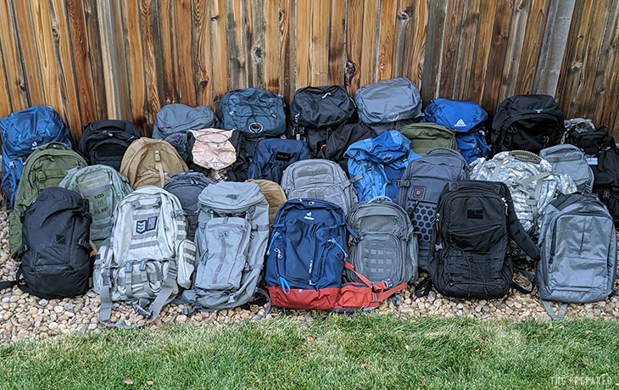
#6 Evacuation 10 minutes to Evacuation
Evacuation! 10 Minutes to Leave! Skip the FEMA Camps by being prepared.
Grab and Go Bin! Store away from the home. Barn, porch, trunk, detached garage.
This is similar to the earthquake kit in Session 1 – Grab case of water, bin/backpacks, food bucket and Go! (Can use the EQ kit)
Notes:
Read the slide.
This is different from the long-term displacement.
This is the same as the earthquake bag with a few extra items (water and a emergency food bucket).
Have a bin that is just for evacuation or earthquake readiness. That means you store it away from the home! You can’t retrieve it from the basement if an earthquake has hit. Store close to the garage door, a barn, a back porch, etc.,
Store cases of water near it. Store a bucket of “just add water” food near it or plan to eat on the road.

Slide 20
Short Term Supplies Items to Consider
A bin for each person:
- change of clothes
- pair of shoes
- hoodie/coat/gloves
- travel size hygiene products
- towels, sleeping bag, pillow
- bed: hammock/blow up mattress
- food and disposable dishes
- small first aid/lip balm and lotion
- family documents
Notes:
Don’t read.
Avoid the FEMA camps at all costs!
You will need a change of clothes and underwear to alternate over the days.
You will need an extra pair of shoes and socks for living outdoors.
A coat or hoodie and gloves for working outdoors.
Travel size hygiene products until you get to a long term location.
Towels to clean up with, a sleeping bag and pillow. Or a pillow case to put the towels in to make a pillow.

Slide 21
Notes:
A temporary bed. Car blow up mattress or a hammock.
A 72 hr. food bucket with paper goods.

Slide 22
#7 Emergency Lanyard
Notes:
This is an ingenious idea! My friend Margene Neilson created this!
She has a lanyard for each member of her family hanging near the door.
You can find the supply list in the temporal preparedness section of nofearpreps.com. She is also the one who does the DIYPreparedness website and the free preparedness binder!
Some of the items: emergency blanket, poncho, ear plugs, pain killer meds, bandaids, pen with mini flashlight, Note paper, spork, compass, hand sanitizer, consecrated oil, whistle, extra house key and car key, chapstick, flash drive containing: documents, pics, social security cards, inventory of home items (insurance claims). Remember to email them to yourself as well!

Slide 23
Review of Emergency Documents
72 hour bin PRE-PACKED - passports, cash, Extra keys to the house and cars, credit card.
Notes:
Remember Store evacuation bin/earthquake bucket/etc., away from the home in case the home gets damaged, it will be easier to dig out.
Pre-pack keys to get back onto your property (put on lanyard).
If you are running from a fire, you will want to pack a copy USB with photos and documents in case the home is destroyed.
The fires in Canada a few years ago evacuated 800,000 people who had 10 minutes or less to leave. They drove through flames. The biggest regret was forgetting the passports because there were no available hotel rooms and they couldn’t cross the border into America.
Cash is accepted in grid down situations. Credit card is good for eating out and getting supplies. Child ID is in case your children get separated from you.
Copies of BC /SS Cards will provide ID if needed. Email copies to yourself, copy of USB, AND make a hard copy. Make inventory list for insurance claims.

Slide 24
#9 Prepare for Possible Nuclear Fall Out
If at home, head to the lowest floor (basement), seal off doors and windows. Bring 72 hr. evacuation bin in with you.
If in the car, avoid watching a blast, roll up the windows, head straight home before the roads become clogged.
If outside, cover your body head-to-toe and burn anything you are wearing when you get home. Wash your hair.
Store potassium-iodine tablets or kelp capsules.
Notes:
Play the slide.
Read the slide.
Share info on radiation tool.

Slide 25
Geiger / Radiation Counter
Notes:
You may want to put this little instrument in your preps if you are concerned there is radiation in your home even after you have sealed off the windows with sheeting and duct tape.
I bought this on Walmart.com.
There are little stickers (the size of a stamp) you can buy to stick on a wall and it will also tell you the level of radiation. (next slide)

Slide 26
RAD Card (Ebay) $19.95
Notes:
This card you put in your wallet. It will go darker if you have been exposed and what level you have been exposed. It is good for 2 years, or if you freeze, up to 10 years.
No battery needed. Not affected by EMP (common with dirty bombs).
Military Grade. USA Made.

Slide 27
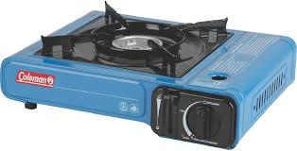
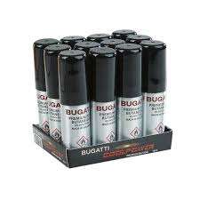
#10 Have Alternative Cooking Sources
Indoors: Butane and Butane Stove, cheap, easy, safe or Kerosene.
Outdoors: BBQ, firepit, volcano stove, solar oven, tent stove, propane stove, wood, thermal (thermos) cooking, charcoal, or coal, Dutch oven, etc.
Notes:
Don’t read.
If you are indoors, with no electricity only use Kerosene or Butane. Propane is not approved for indoor cooking. The butane stoves and cans are really inexpensive. Walmart of Amazon.

Slide 28
Outdoor Cooking
Notes:
If cooking outdoors, you have more options, however, keep in mind that you and thousands of others will be looking for wood to burn (and that wood has to be cured for 6 months) so pre-store some cooking supplies. The more options you have the better. You will be helping others I’m sure.
A fire pit with tripod and Dutch oven ware.
A rocket stove (add small branches) to burn through the side.

Slide 29
More Outdoor Cooking Options
Notes:
A lava stove on the left, uses 3 fuel sources: briquettes, wood, or propane. Runs about $100. Store briquettes in buckets to keep moisture from ruining them.
The solar oven on the right can run up to $300. Very effective for more than just cooking. You can heat water for bathing. You can heat bean bags (use a sock, fill with beans or rice, tie off the end) and warm your sleeping bag. You can pasteurize water. You can make these for $10 or less if you Google search them. There is one with a BYU professor showing how to make them with a car shade. Make several of them!
There are other options: GoSun is similar to the oven, but it is a tube that cooks meat in 10 min. or less. A propane oven looks like a countertop toaster oven and runs on propane. You can get up to 8 hours of baking with 1 1lb propane bottle.
There is a thermos jack which works like a thermos. You boil water, put it in the pot, cover and put in insulated bag for a few hours and the meal cooks.

Slide 30
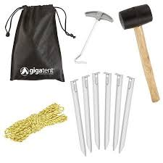
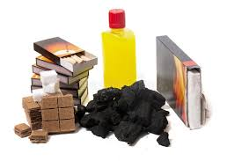
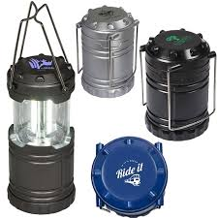
#11 Quick 2 Hour Camp Set-Up Bin
For an easier transition to setting up camp, put the “needed first” items in a bin.
Tent Stakes and tools
Just add-water-only foods
Firestarter, matches, wood
Lanterns
Duct Tape, assorted tape
Batteries
Trash Bags
Notes:
Don’t read.
Ever go camping and can’t find anything making everyone miserable including yourself and frustrated because it is taking so long?
Go prepared. Put into one bin the first 24 hours of supplies:
A lantern, matches to light a fire, tent stakes and mallet, easy canned meals, you get the point
You can put back up batteries, trash bags and duct tape for easy retrieval.

Slide 31
#12 The Camp Kitchen All Ready To Go!
Notes:
I filled my Stanley Fat Max with all the kitchen utensils, tools, and hot pads I would need. I found almost all of it at the dollar store. However, if I need to leave long term, I will dump my kitchen drawers into bins and take all that I have!

Slide 32
Outdoor Kitchen Set Up
Notes:
As time goes on, you may want to consider organizing an outdoor kitchen. If you don’t want to dig a pit, consider a dutch oven table to cook on. Regular folding white tables will help with different cooking preparations and clean up. A camp kitchen set up like the one from Coleman on the left is handy.

Slide 33
#13 “Zone Within A Zone”
Put small pup tents inside bigger tents to trap heat.
Set up large tent in basement to trap heat.
Layer clothes x3 to trap heat. Do not use cotton next to skin, sweat freezes into mini-ice cubes.
Lay plastic over garden and cover again with a box to trap heat. Greenhouse effect.
Notes:
When you “layer” something you create heat.
If you put a small pup tent inside a bigger tent, you create a “zone within a zone” and you trap heat and don’t use as much fuel to keep the tent warm.
If you put a tent in the basement you trap heat and can get warmer faster and longer.
When you use multiple layers of clothing, you trap heat and stay warmer longer. Do not put cotton next to your skin in the winter! When you sweat it causes the sweat to be trapped and turn into mini-ice cubes. Use polyester! Save the cotton for summer!

Slide 34
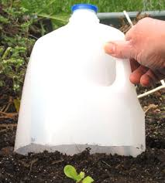
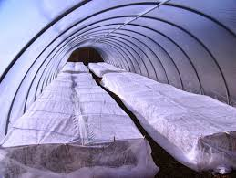
“Zone within a Zone” with growing food.
Notes:
If you cover your plants with plastic and then put another cover 12 or more inches higher, you create a greenhouse effect and you can grow foods in deep winter conditions! Must be “winter vegetable type” plants. There is a book on Amazon called “The Winter Harvest Handbook” by Elliot Coleman that goes into more detail. He grows and sells food in Maine all winter long!
You could recycle milk cartons to create a mini-green house. You can cover the milk cartons with sheeting as the weather gets below freezing. Keep the lids to control the air flow!
You can also grow plants inside near windows. Set up tables, protect your floor with rubber mats and bucket garden in the winter!

Slide 35
#14 Organizing Camp in a Crisis
Have an information area away from sleeping area. Post updates.
Have a visiting area with chairs around a camp fire.
Eat meals as pot luck when possible.
Have daily camp meetings and duty assignments.
Have buckets for shoes by tent door.
Have private quiet areas assigned.
Have communal area for sharing resources.
Keep smells downwind.
Notes:
Don’t read.
When you are in a crisis, it is better to group with other like minded individuals than it is to “go it alone”. When you are alone, you are a target for gangs and marauders. Consider forming your group ahead of time to prep together.
Set out specific use spots in camp to maintain peace, quiet, and sanitation.
- Have an information area where updates and messages are posted.
- Keep sleeping areas away from camp socializing areas.
- Eat at least one meal a day as pot luck to avoid food exhaustion and lack of supplies.
- Have daily camp meetings and duty assignments to keep communication open for counsel.
- Have buckets by the tent opening for shoes to be stored in to stop tracking dirt in.
- Have private and quiet areas assigned, curfews, children areas, etc.,
- Have a table/tent where people can use “extras” of others: tools, shoes, clothes, etc.
- Keep smells downwind. Store garbage and sewage on the outskirts of camp.

Slide 36
#15 Know Your Wild Plants For Food
Cat tail (protein)
Wild Asparagus (veggie)
Dandelion (Vitamin C)
Elderberry (immune system)
Sunflower (seeds)
Prickly Pear Cactus (grilled)
Pine needles (Vitamin C)
Notes:
Read the slide.
Enzymes come from live plants. Enzymes are essential in our diets to keep us healthy and to fight disease and cancer. When you process food, you kill the enzymes. When you pick food and store, the enzymes die within 20 minutes.
We need to have fresh enzymes, preferably daily. This comes from picking food from the tree, vine, bush and eating it immediately. Eating plants in the wild can help with that. Having a small garden can help.
Make a cat tail smoothie! Make a weed salad! Pick berries and snack. Make a hot tea. The plants are all around us!

Slide 37
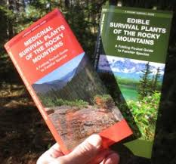
Good Books for Identifying Plants
Notes:
You can search on the internet and make lists with pictures of plants that are edible in the Rocky Mountains or there are several books you can buy.
It is a fun activity to find an empty lot or hill nearby and see how many plants you can identify with your children.
Have them go find 1 plant a day and identify it in a book and talk about it’s features and nutritional value.
Get the whole family involved! It’s as if God put gifts all around us and we ignore them thinking there is something better in the store. What generations have called weeds were actually powerful plants to heal us.

Slide 38
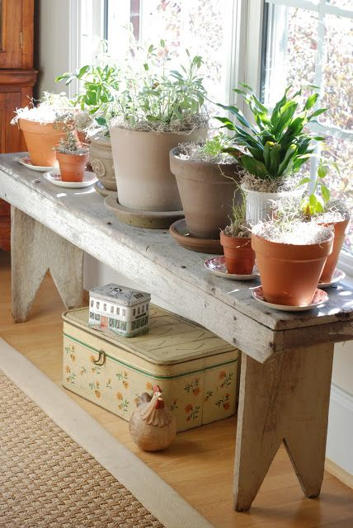
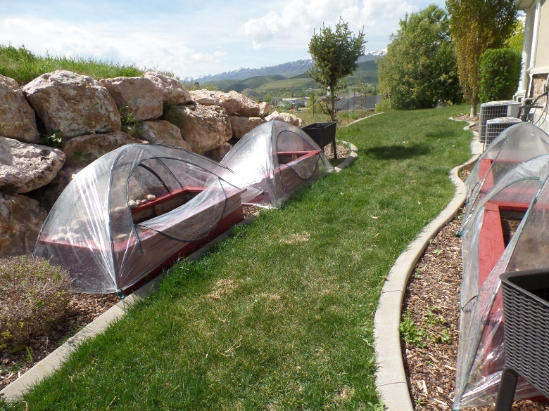
#15 Make Temporary Green Houses
Grow year round if you have windows to set tables with buckets/trays on. (Protect floor)
Make a wrap over your plants with clear sheeting or cellophane.
Notes:
Don’t read.
When possible, grow food year round. In the last slide we will see how to grow sprouts for the fastest way to get fresh food in 48 hours, but you can grow year round in snow conditions certain veggies if you know how to do the zone within a zone.
Make frames from sticks and wrap cellophane around the sticks.
Buy greenhouse domes to protect plants during freezing nights. I bought mine online.

Slide 39
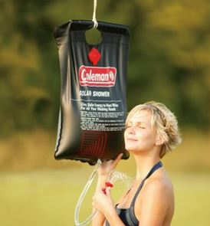
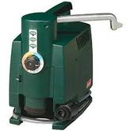
#16 Clean Up Station
Put soap in stocking, hang from tree. Get hands wet, and rub the soap.
Solar Shower Bag.
Coleman Hot Water on Demand (batteries and 1 lb propane bottle)
Notes:
Don’t read.
Keeping hands and faces clean in camp or the backyard helps to minimize sickness.
Hang a nylon from a tree and put a bar of soap in the nylon. After you get your hands wet, rub the soap and work up a lather. Keeps the soap from being dropped or messing up the sink.
A solar shower bag works to heat up water.
A solar oven will heat up water. I like to put the water in plastic bottles to slip into my sleeping bag!
A Coleman Hot Water on Demand (takes batteries and 1 lb propane tanks) heats up water in 4 seconds. Works great with showers and doing dishes.

Slide 40
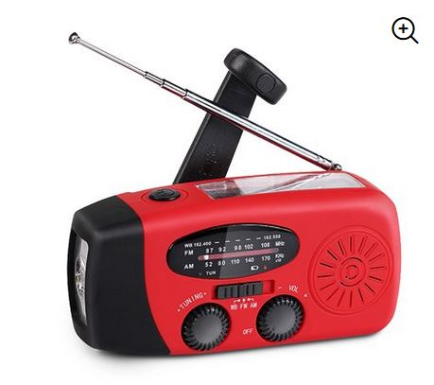
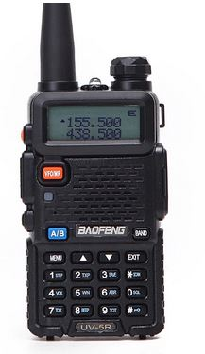
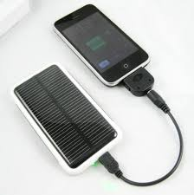
#17 Set Up a Command Station
Laptop
Weather Crank Radio
Clipboard
Paper/Pens/Pencils/Sharpie
Solar Charger – phone
Solar Charger – laptop
Table and Chair
Ham Radio/2-way Radio
Notes:
When there is a crisis and you are displaced or still at home with no electricity, grab your communications bag!
Charge your phones and lap tops with a solar charger. I showed in a previous slide to use your laptop battery for charging additional USB lights.
You will want to have a mini office. You want to listen to radio weather reports, news, etc., You may want to have communications with others by two way radio or ham radio.

Slide 41
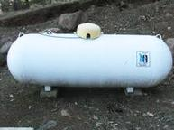
#18 Alternative Fuel Long Term Storage
Propane Tank
Whole House Generator
Gasoline Generator
Wood and a good ax. Do not rely on when thousands of others are looking for the same source, wood needs months to cure.
Notes:
Don’t read.
Propane tank, this will store indefinitely. If you have the resources to have a tank buried, it could get you through two very hard winters if you only use it for heating. It would take a 1,000 gallon tank. It would take a connection to switch over from natural gas to propane and you could never return to natural gas again once propane goes into the line.
A whole house generator is run by natural gas or propane. It will run the big appliances and an air conditioner. We live in an area where the electricity goes off regularly and so we installed one that comes on on its own when the electricity shuts off.
A gasoline generator is good for those short term crisis moments, but keeping enough gasoline on hand can become a problem. Also, the noise is a nuisance and it will give away to robbers that you have one.
Although I don’t have a picture of wood, keep in mind that thousands of others will be looking for cured wood once energy becomes a long term problem. Be ready. Have a good ax and splitter for the times you have wood available.

Slide 42
#19 Best Animals for Backyard Meat Source
Chickens lay eggs daily.
Rabbits reproduce every 40 days.
Goats are small and provide milk for cheese.
Fish are free if you have a water source nearby.
Notes:
Don’t read.
There may come a time when you need to raise some animals on your own. The best in a small non-farm situation would be:
Chickens for eggs.
Rabbits – reproduce every 30 days.
Goats provide a source of meat and cheese and don’t require large amounts of feed.
Fish if you have access to a nearby lake, river, ocean, etc.,

Slide 43
#20 How to Get Healthy Food Quick!
Sprout seeds! Soak them in water for 24-72 hours and eat the crunchy, leafy, tasty sprouts!
Sprouts have more protein and essential enzymes than meat.
Sprouts help immune system, heart disease, stomach acid.
Faster than waiting on a garden.
Notes:
Don’t read.
A brief push for Sprouting
Other presenters have covered this topic, but I think each of us have added to the knowledge base of sprouting.
Read slide.

Slide 44
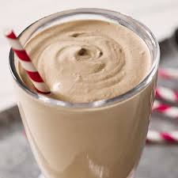
#21 Milk Substitution – Rice Milk
Hate powdered milk? You’re gonna love this!!
4 cups of cooked rice, rinsed.
4 cups of cold water.
Blend, run through strainer or cheese cloth.
Add: stevia or vanilla
For “rice shakes”
Add 1 scoop of protein powder.
Add 1 frozen banana
YUMMY!
Add any fruit! Use stevia to balance any tart or bitter taste.
Notes:
Don’t read.
Hate powdered milk? You’re going love this! Pennies per serving. Easy to make. Kids will drink this all day long. They won’t even miss having milk!
Read the recipe.
4 cups of rice (instapot or rice cooker) rinse and cool down.
4 cups of cold water, blend! I like 5 cups…add water to your desired thickness.
Run through strainer or cheese cloth. Add stevia or vanilla to sweeten
Make “rice shakes” with adding 1 scoop of protein powder and 1 frozen banana! The banana makes the shake thick and sweet! The powder makes it taste more like regular milk!
You can add any fruit or spinach or whatever you use in smoothies. Just say goodbye to milk!

Slide 45
#22 Deer Carts
Notes:
This is one of my favorite ideas!
I have 6 of these. This will help you move your preps around camp, loading and unloading, and it will help you to carry preps if you are on a long walk to relocate or escaping an area. It will carry wounded or sick. It is built to hold 500 pounds.
It is light weight. It costs less than $100 (Amazon). Make sure the wheels don’t need air (hard rubber) and the spokes are not thin to be broken by sticks you are pushing through.

Slide 46
#23 Stoves for Traveling
Notes:
I bought a titanium stove (left) because the bottom will not burn out. It is only 12 pounds. It can be set up in an RV and the pipe run through the ceiling vent, it can be placed on a board on a deer cart and you can cook food while you are traveling. A rocket stove could probably do the same thing. Titanium can be spendy.
When I bought the stove pipe, it came in a large piece of sheeting and I can use that to cut squares to put in other tent stoves to stop the bottom from burning out.

Slide 47
#24 First Aid Must Haves
Notes:
There are so many first aid kits out there. All of them have lots of little things you will probably need, but they are missing some of the bigger items that will be essential.
A blood pressure cuff (manual, requires no batteries) will help you assess if someone is in shock or requires medical attention immediately. $25 Amazon
A stitching kit for lacerations and there is no medical help available.
I bought mine on Amazon for $20

Slide 48
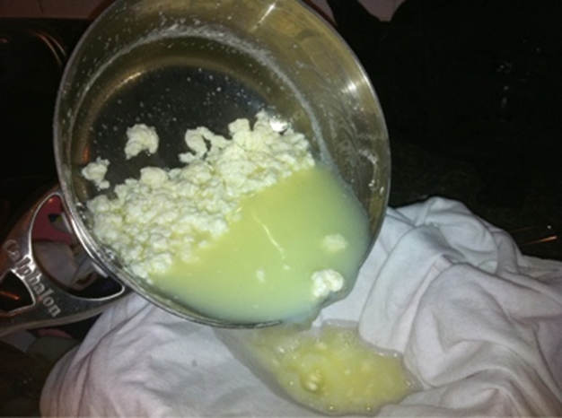
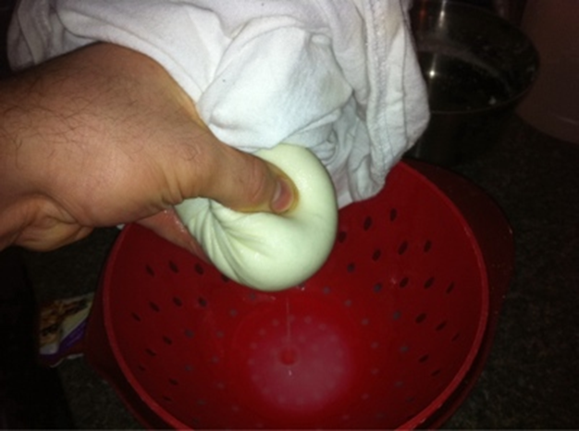
#25 How to Make Cheese from Powdered Milk
Notes:
This is a quick introduction, but to get the full instructions, you can download them at nofearpreps.com in the temporal preparedness section.
Mix water and powdered milk in a pan on the stove. Keeping the temperature to a low to medium heat without scalding. Once warm, add some vinegar or lemon juice.
You will start to see curds form. Add more vinegar if there is more whey left to form more curds.
Pour the curds and whey through a piece of cloth (t-shirt or cheesecloth) and rinse with water. Squeeze remaining liquid out. Ta da! Cheese for lasagna!!

Slide 49
#26 Camp Dishes
Notes:
If you are camping long term, be sure to store up large cooking pots and rod iron skillets and dutch ovens.
You can use pie tins for plates to endure the camp conditions. I bought 50 of the pie plates for $33.

Slide 50
#27 Spice Bucket
Notes:
You can make cardboard taste good if you have some great sauces and spices!
Here’s a list of some that I like:
Taco seasoning, Italian Seasoning, Greek Seasoning, Kung Pao Sauces, Duck Sauce, Sweet & Sour Sauce, Mongolian Sauce, Powdered cheese, Carribean Jerk Sauce, Hot Sauce, Lemon Pepper, and of course, Salt & Pepper and Garlic.

Slide 51
#28 Laundry Tips
Notes:
Laundry is going to be hard without electricity.
Keep buckets of vinegar (store up vinegar) and water to soak items before laundry day.
You can put them in a 5 gallon bucket with water and soap and use a plunger with holes to create an agitation motion.
Move to a clean bucket to rinse. Then wring out to dry. I bought a mop wringer to do the rinsing and wringing. There are other ideas on the internet. Google “off grid laundry”.
I brought this up before. Store up aprons! They are easier to clean and it doesn’t matter if they get dirty.

Slide 52
#29 A MacGyver Bucket
Notes:
Remember the movie MacGyver? He could fix anything? You will be needing quick access to items other than a normal tool box such as:
Tape, all kinds
Glue, all kinds
Paracord, string, twine, wire
Scissors, tin snips, a mallet,
What else can you think of?

Slide 53
#30 Military & Weapons Bucket
Notes:
There are items that will come in handy that the military uses for surveillance and treks. These items can be found at most arm/navy stores.
Binoculars, night vision, hammock netting, ammo belt, knives, machetes

Slide 54
Bonus: #31 Spiritual Bucket
Notes:
You will still hold services and devotionals in a grid down situation. It will be nice to have materials you can study from.

Slide 55
The Next Session
The ins and outs of storing food long term and short term.
Storing some water.
How much food do you need?
How to plan meals with the food stored.
My email: cimprint@live.com
Notes:
Read slide.
Feel free to contact me with ideas or questions. cimprint@live.com
Remember, you become the calm.

